Slide 1

Resilience & Recalibration:
Forecasting the New Orleans Office Market
Cres Gardner, CCIM, SIOR
Beau Box Commercial Real Estate
NOMAR Forecast Conference
Fall 2025

Slide 2

AGENDA
COVID’s Impact on the Office Market
Year over Year Statistics
2026 Forecast: Bottom or Bounce?
Future of Office in New Orleans
Risks, Opportunities & Final Takeaways

Slide 3

COVID’S IMPACT ON THE OFFICE MARKET

Slide 4
Class A Occupancy Comparison:
CBD vs. Metairie
(2019–2025)
CBD Class A Occupancy Change: -8.1%
Metairie Class A Occupancy Change: -6.7%
Source: Corporate Realty, Q2 2025 Market Report

Slide 5
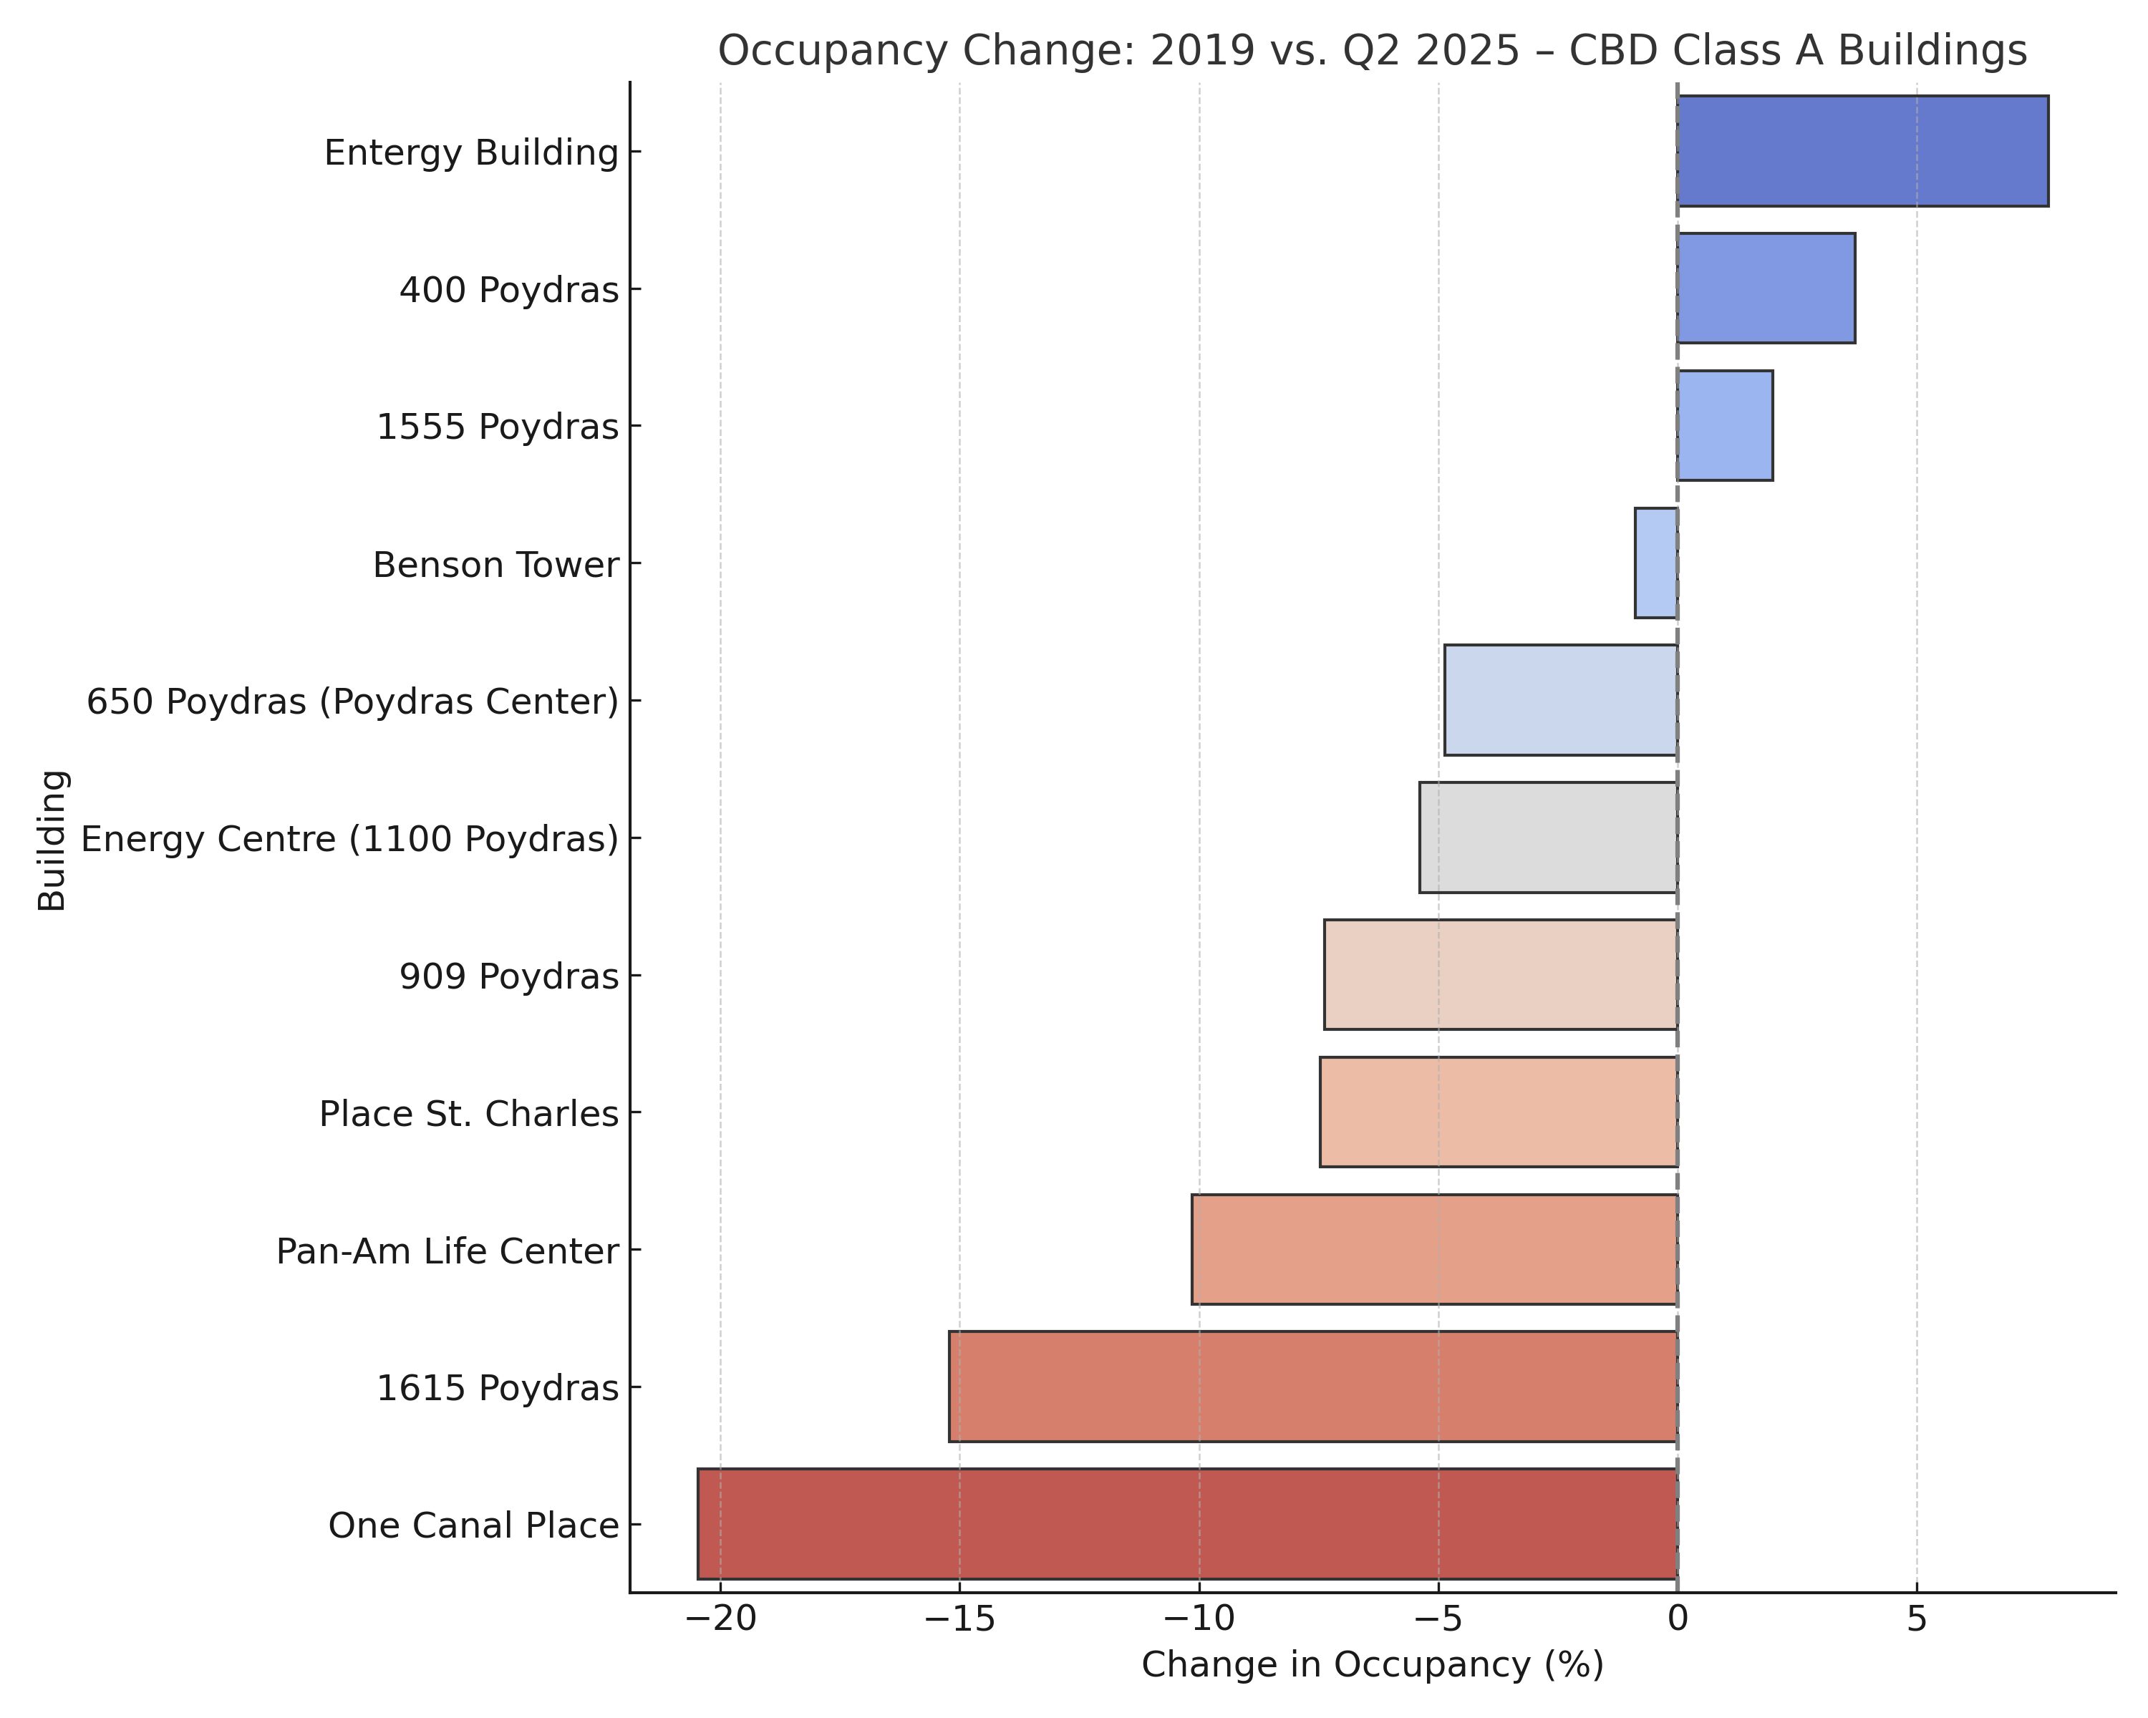

Slide 6
Class A Office Rents:
2019 → 2025
CBD
2019: $20.08
2025: $20.71
+3.1%
Metairie
  2019: $19.21
  2025: $25.06
+30.5%
Source: Corporate Realty Market Reports (Q2 2019 & Q2 2025)

Slide 7
2025
year in review

Slide 8
Class A Occupancy Comparison:
CBD vs. Metairie
(2024–2025)
CBD Class A Occupancy Change: +0.34%
Metairie Class A Occupancy Change: -0.10%
Source: Corporate Realty Market Reports (Q3 2024 & Q2 2025)

Slide 9
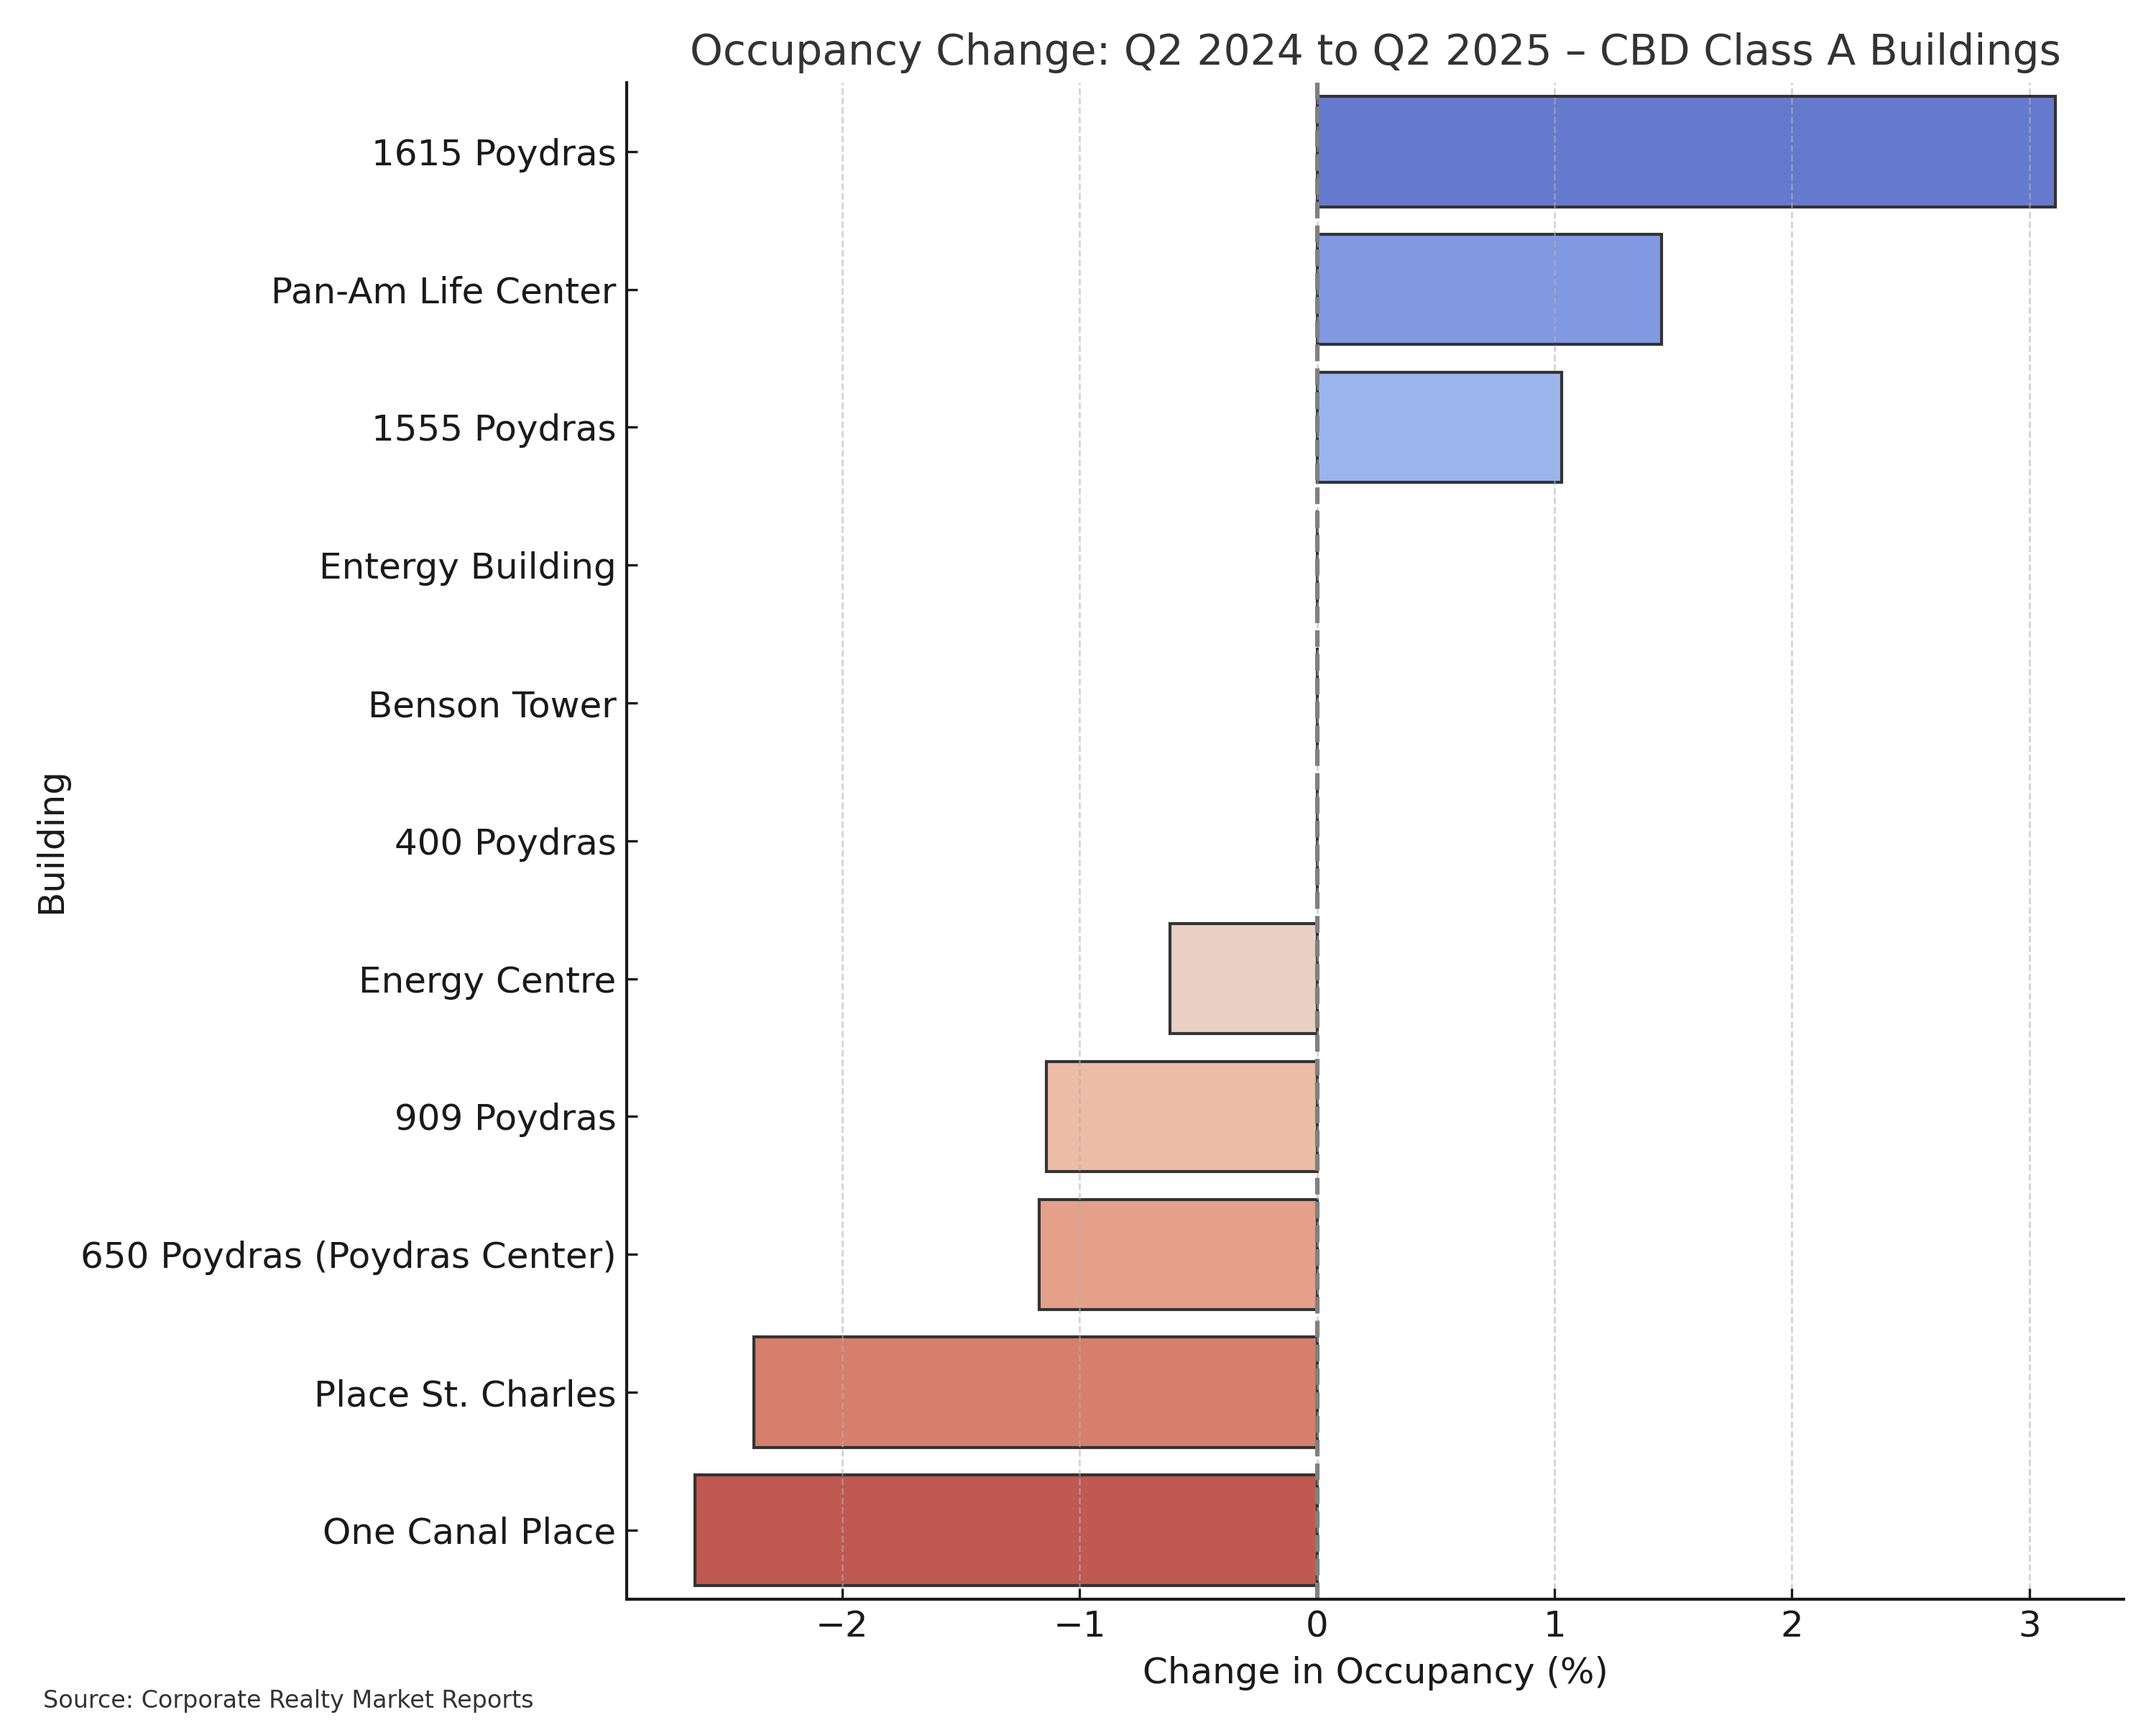

Slide 10
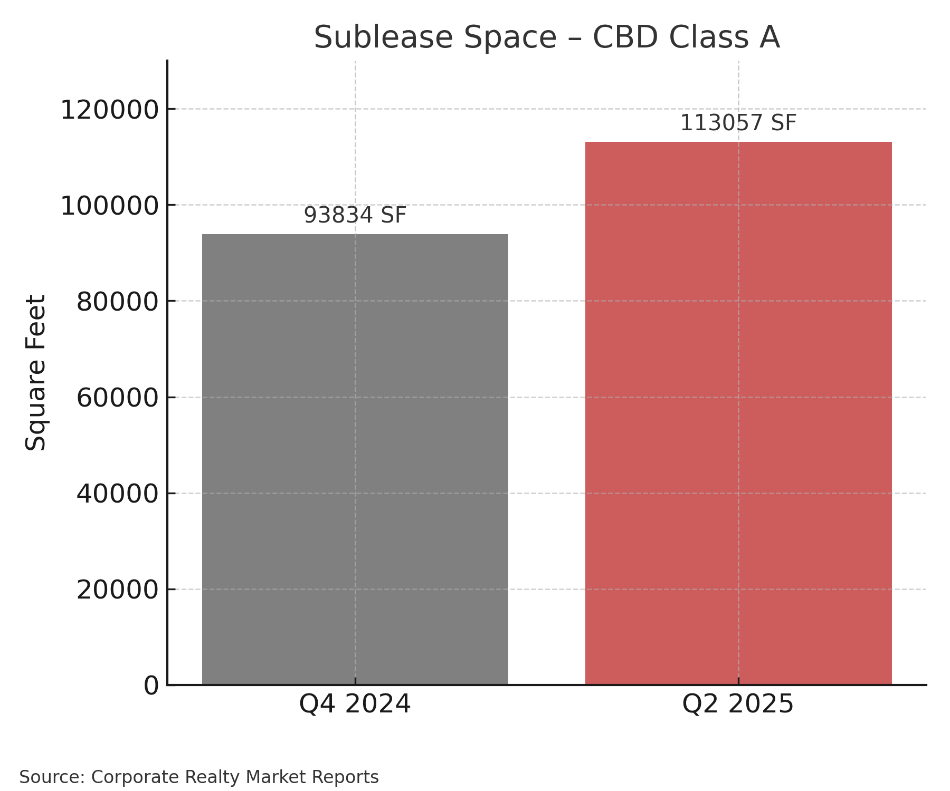

Slide 11
Westbank Market Overview
High occupancy at 91.69% – one of the strongest in the region
Performance has remained steady post-COVID with minimal volatility
Resilient tenant base less impacted by remote work trends

Slide 12



Kenner Market Overview
Class A occupancy at 91.79%, with positive absorption in 2025
Tight market supported by smaller tenants and low turnover
Quiet performer with high stability and little churn

Slide 13



Elmwood Market Overview
Class A occupancy holding strong at 87.54%
Consistent demand from healthcare, logistics, and services
Sticky tenant base with limited year-over-year change

Slide 14

Office Forecast 2026 & Beyond

Slide 15

2026 Forecast
Occupancy has stabilized and will experience slight increase in the CBD and 2-3% increase in Metairie Class A
Rental Rates will continue to slowly increase
Significant changes in CBD ownership
Capital markets challenges will be unique to the asset

Slide 16
Beyond 2026
Conversion activity will reduce CBD supply by over 750,000 sf, thereby increasing occupancy and rates
Metairie occupancy will reach and sustain near 90%
CBD will stabilize at current levels until 2028, when Shell impact realized
Emergence of small scale, high quality new construction alternatives for users seeking a different type of office space

Slide 17
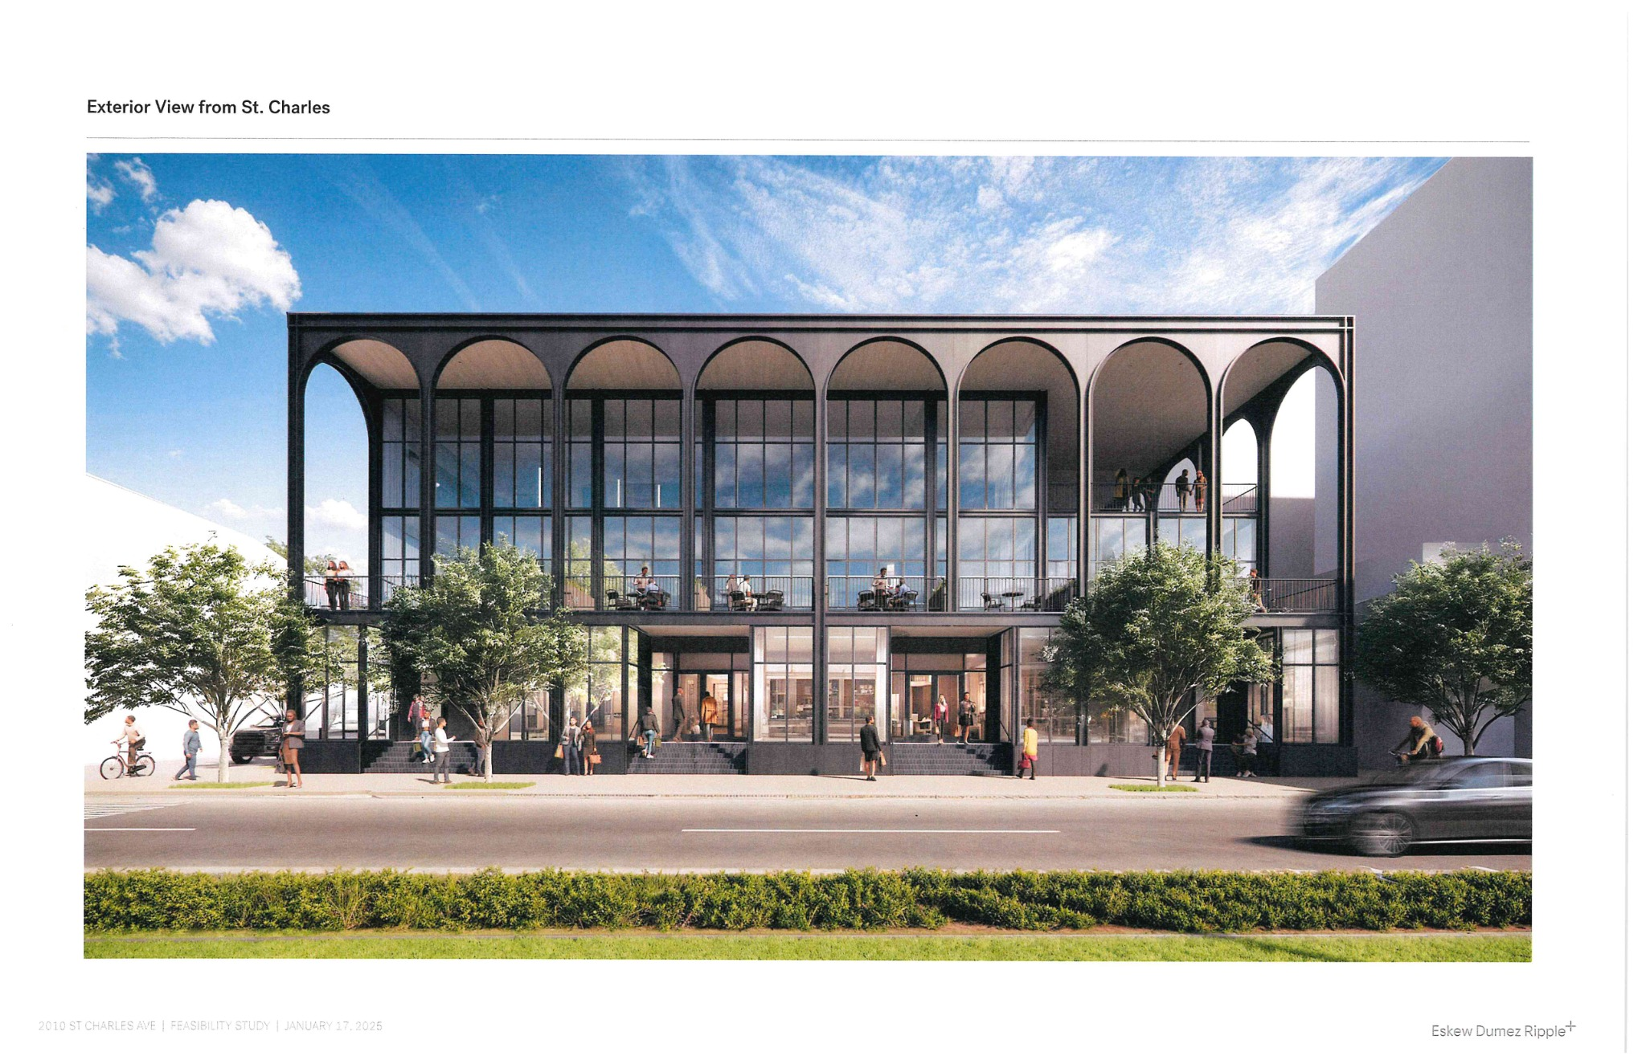
New Construction – Really?
Predicting development of several high-quality small-scale office buildings over the next 5 years.
Discerning users are seeking alternatives to traditional market office offerings
Rates will need to be in the mid $30s psf NNN to justify

Slide 18
Forecast Summary
Occupancy has stabilized across CBD and suburban Class A
Flight to fit continues to drive demand for renovated mid-sized spaces
Sublease absorption may buoy activity in early 2026
New construction limited to marquee users – opportunity to reposition B product

Slide 19

Closing Takeaways
New Orleans office demand is smaller, more selective, and still evolving
Submarkets like Kenner, Westbank, and Elmwood are quietly outperforming
Success hinges on location, walkability, and user-specific buildouts
Market momentum is muted but stable
Flexibility will define winners

Slide 20

Contact Information
Cres Gardner, CCIM, SIOR
Vice President
Beau Box Commercial Real Estate
909 Poydras, Suite 3025
New Orleans, LA 70112
O: 504.799.3119
C: 504.261.2032
Licensed by the Louisiana Real Estate Commission
Beau Box Commercial Real Estate
Broker of Record: Beau J. Box
Licensed by the Louisiana Real Estate Commission,
The Mississippi Real Estate Commission,
The Alabama Real Estate Commission,
& The Florida Real Estate Commission

