Slide 1



State of Multifamily in New Orleans — Economic Forecast 2026
BREAKING GROUND: THE EMERGENCE OF A NEW ECONOMY
THE 15TH ANNUAL
ECONOMIC & REAL ESTATE
SYMPOSIUM

Slide 2

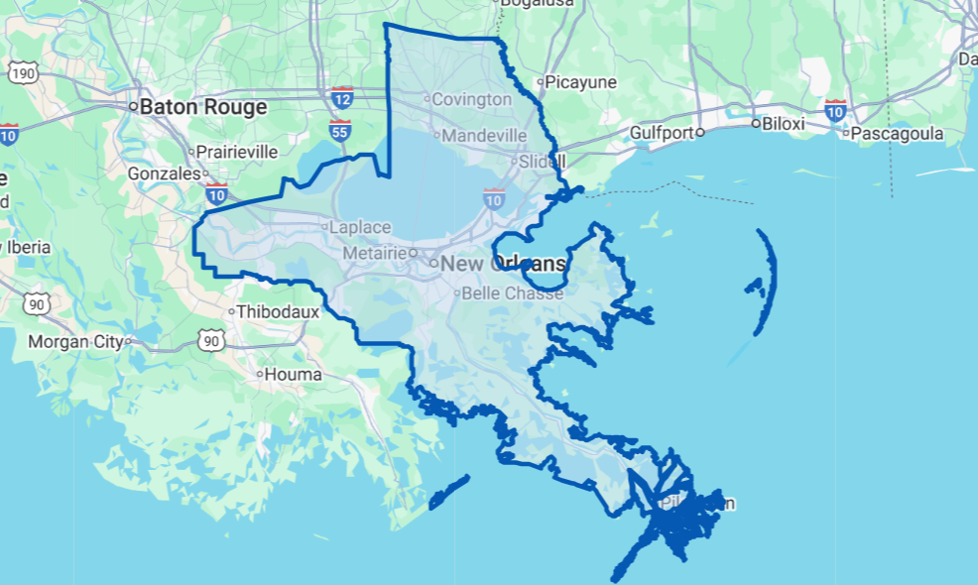
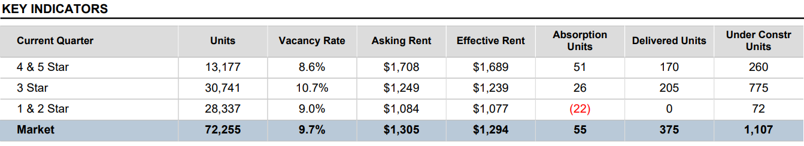
Market Fundamentals
BREAKING GROUND: THE EMERGENCE OF A NEW ECONOMY
Over the last year, vacancies have expanded by around
100 bps across all asset types within the New Orleans multifamily submarket. The current rate of 9.7% is nearing ten-year highs. While small supply-side pressures remain a driver of some of this expansion, the declining population has amplified the vacancies.
Orleans Co-Star Market
THE 15TH ANNUAL
ECONOMIC & REAL ESTATE
SYMPOSIUM
Notes:
Add what the chart is and a map showing where the data is pulled from

Slide 3

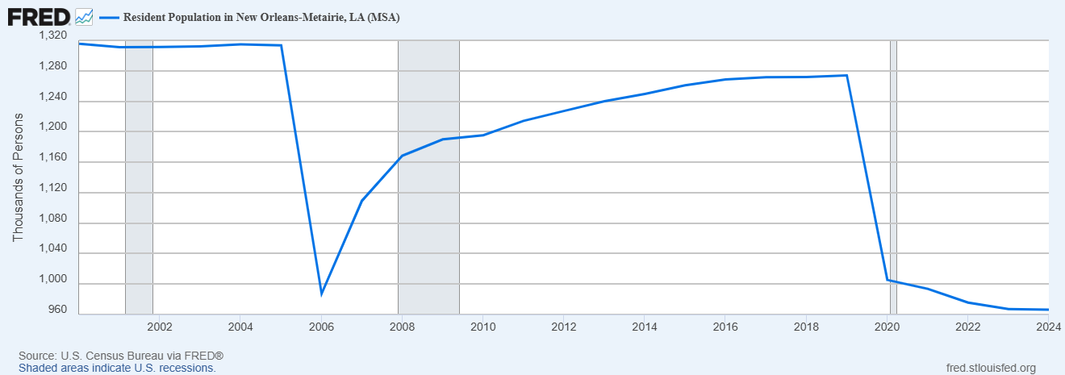
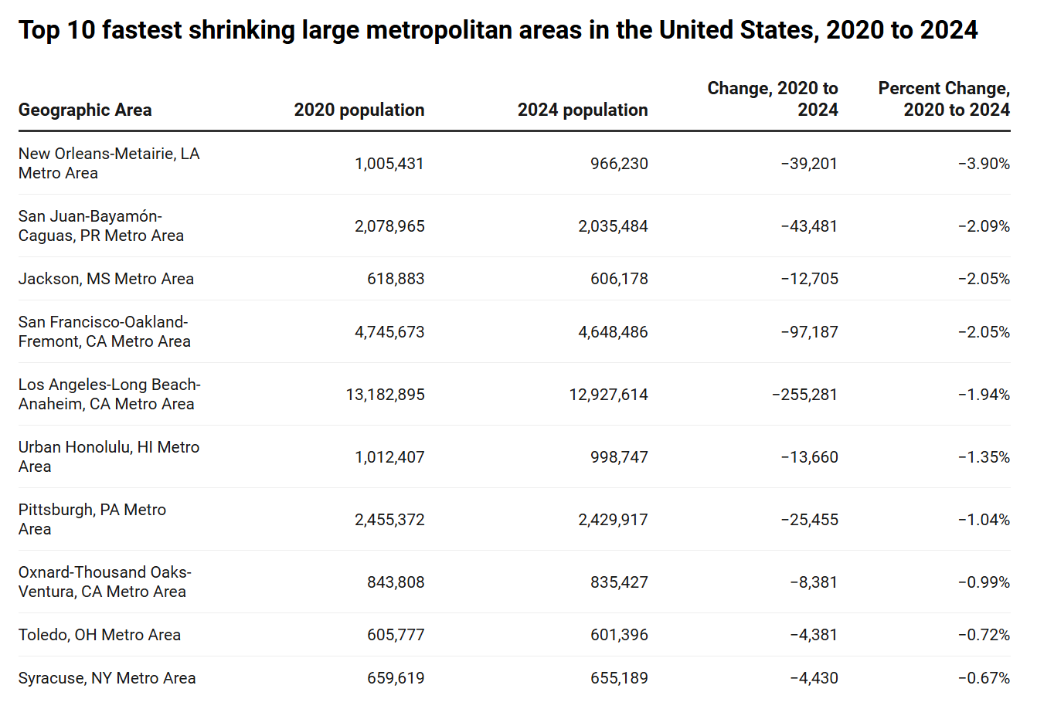

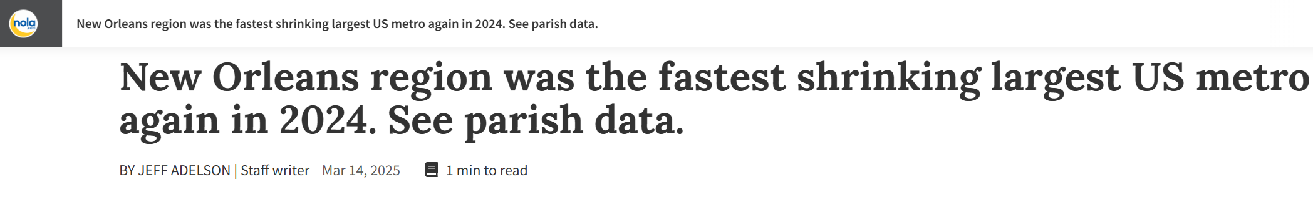
BREAKING GROUND: THE EMERGENCE OF A NEW ECONOMY
Market Fundamentals
THE 15TH ANNUAL
ECONOMIC & REAL ESTATE
SYMPOSIUM

Slide 4
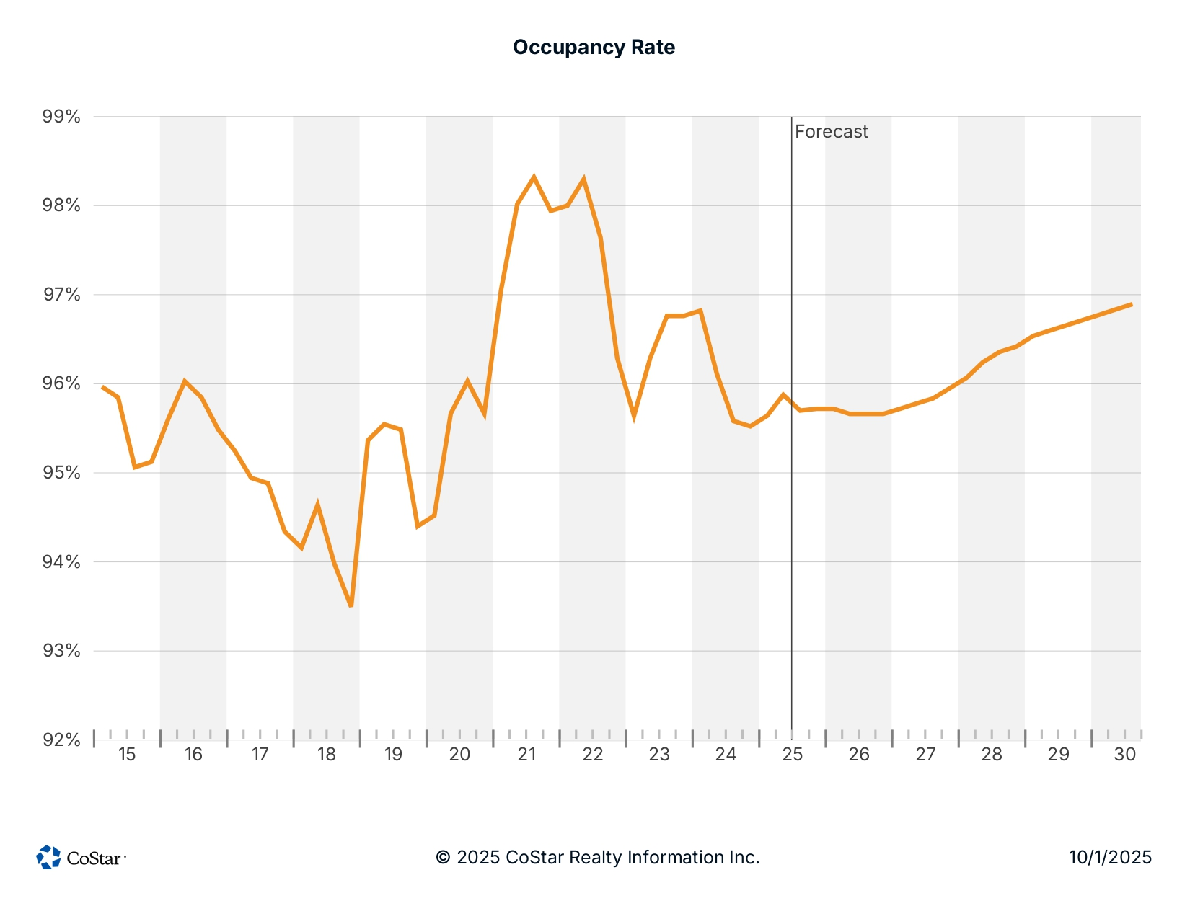
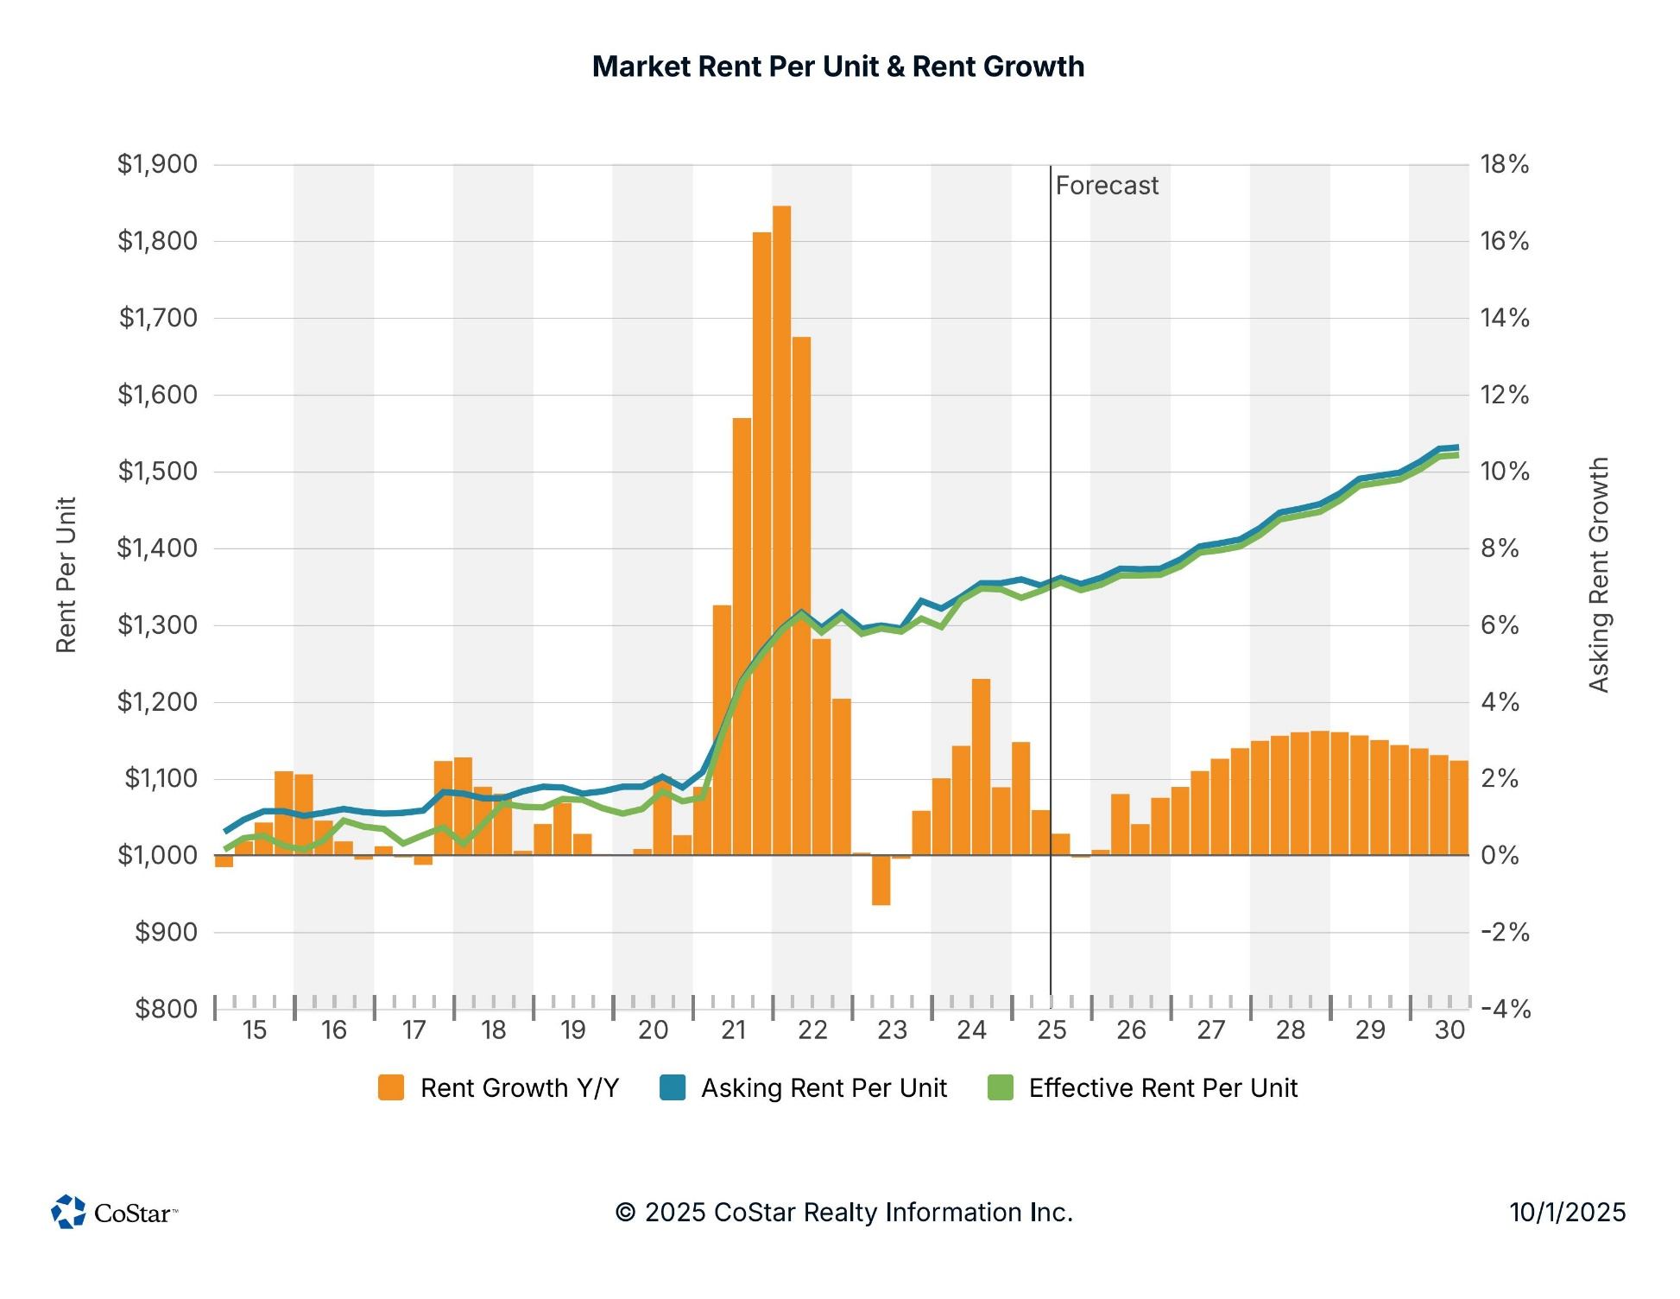
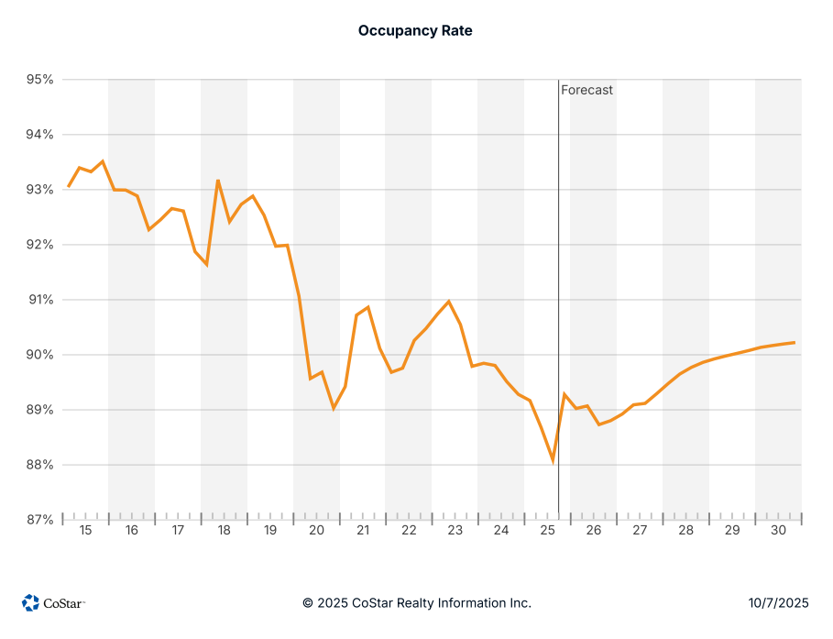
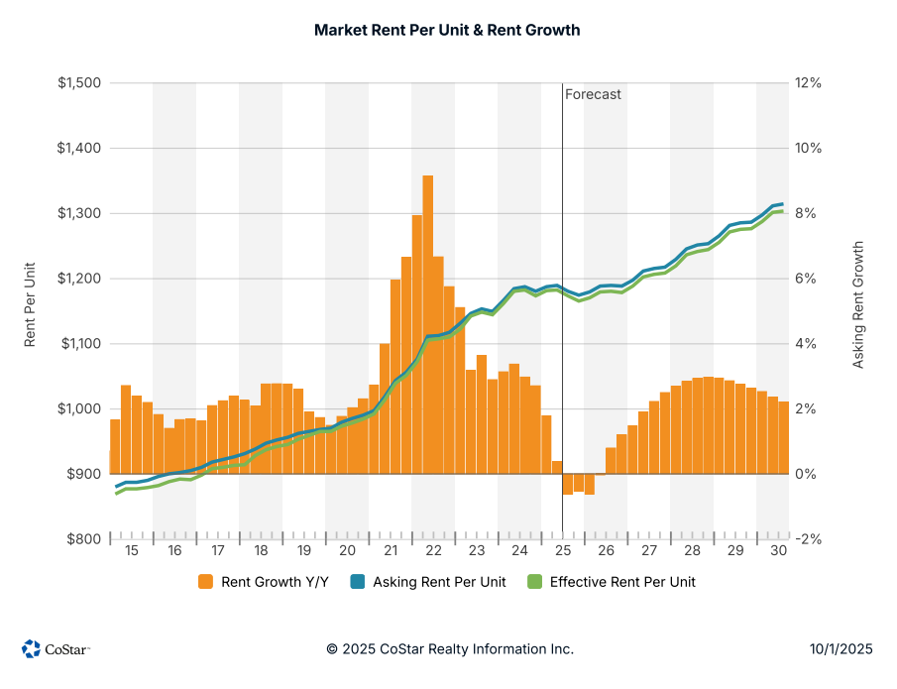
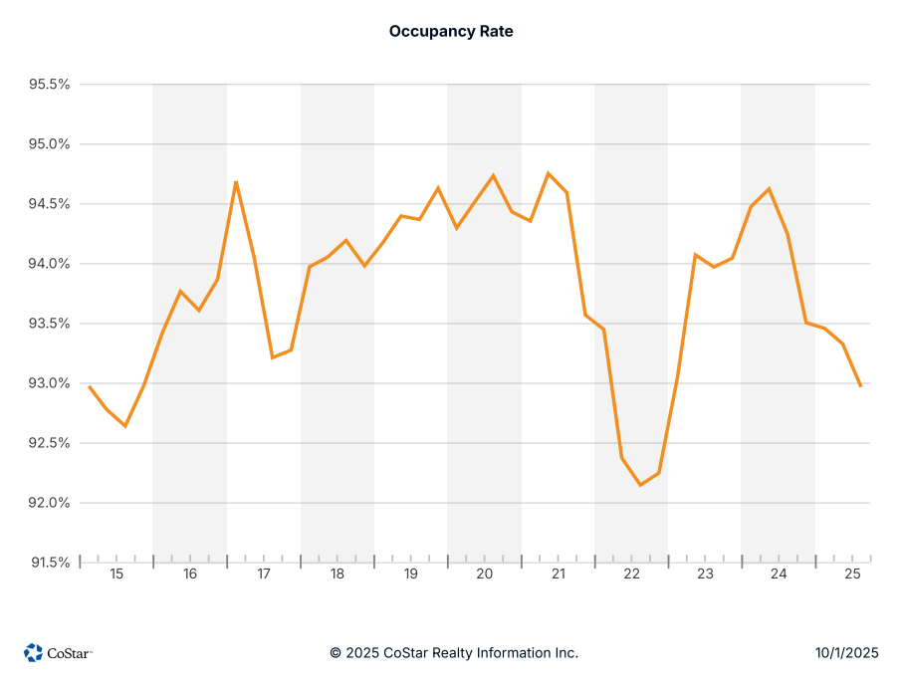
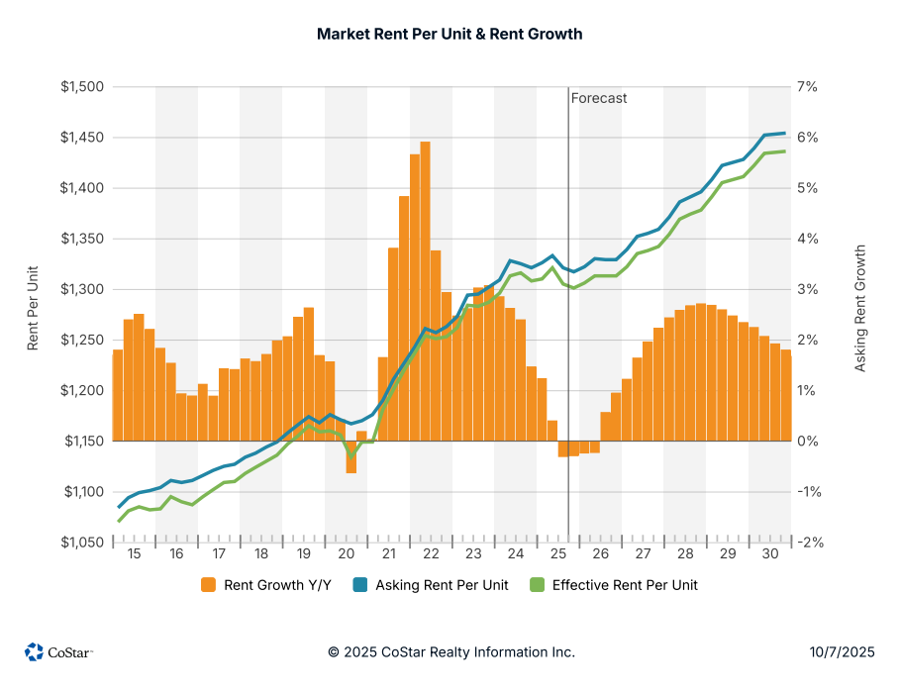
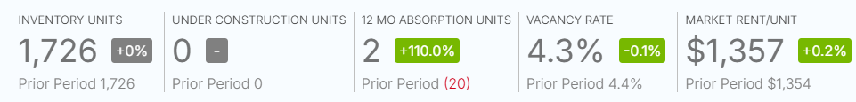
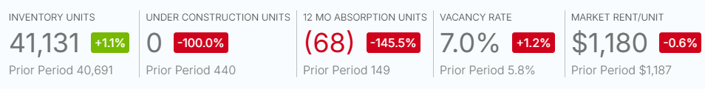
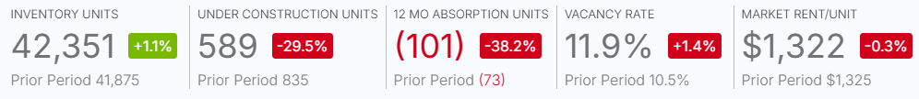
BREAKING GROUND: THE EMERGENCE OF A NEW ECONOMY
GNO Submarkets
Orleans
THE 15TH ANNUAL
ECONOMIC & REAL ESTATE
SYMPOSIUM
Notes:
Add orleans first for a pulse. Really dig into it.

Slide 5
BREAKING GROUND: THE EMERGENCE OF A NEW ECONOMY
GNO Submarkets
jefferson
THE 15TH ANNUAL
ECONOMIC & REAL ESTATE
SYMPOSIUM
Notes:
Add orleans first for a pulse. Really dig into it.

Slide 6
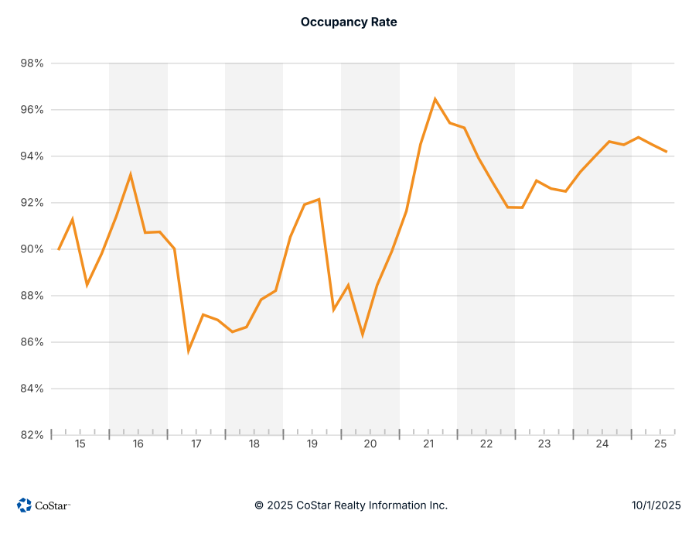
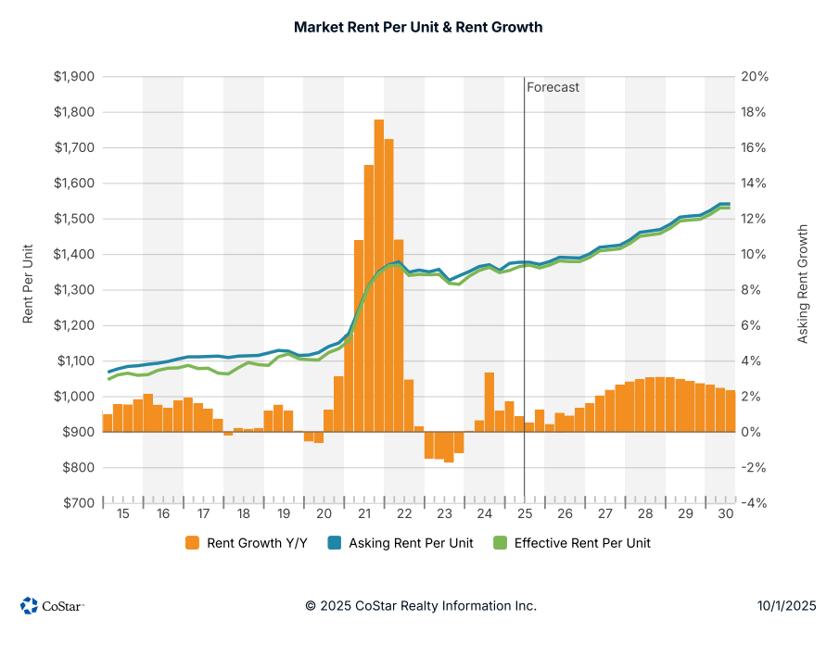
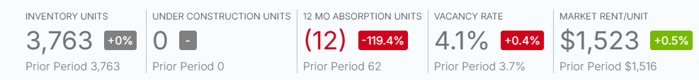
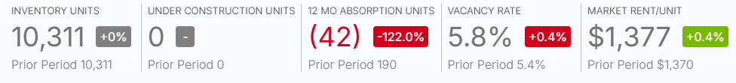
BREAKING GROUND: THE EMERGENCE OF A NEW ECONOMY
GNO Submarkets
St. tammany
THE 15TH ANNUAL
ECONOMIC & REAL ESTATE
SYMPOSIUM

Slide 7
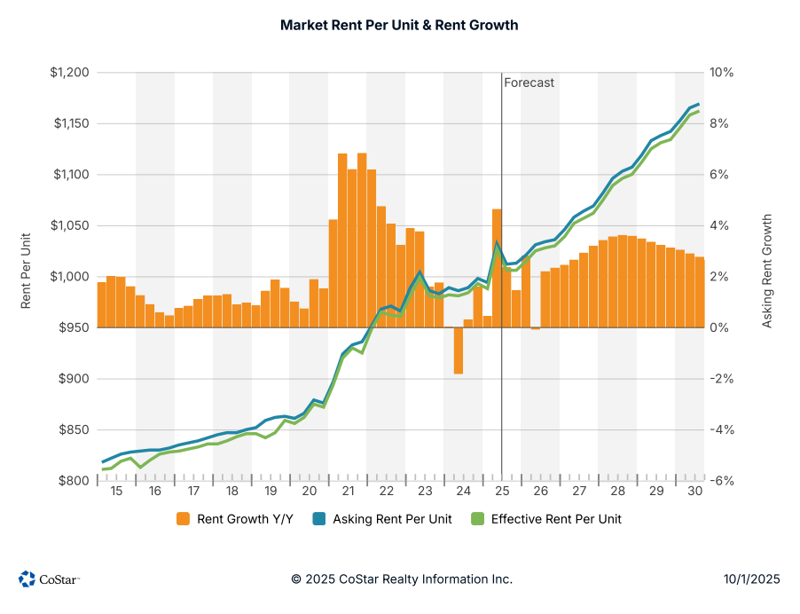
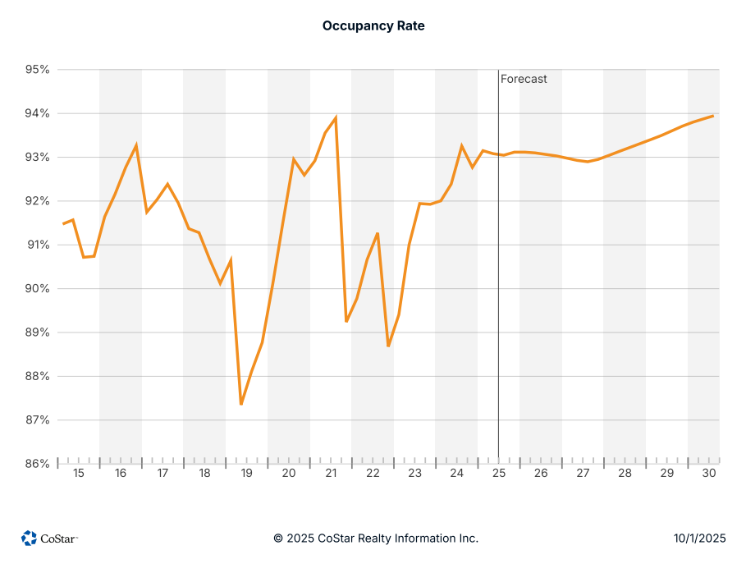
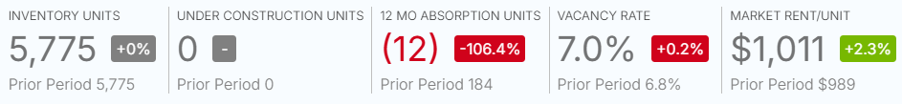
BREAKING GROUND: THE EMERGENCE OF A NEW ECONOMY
GNO Submarkets
tangipahoa
THE 15TH ANNUAL
ECONOMIC & REAL ESTATE
SYMPOSIUM

Slide 8
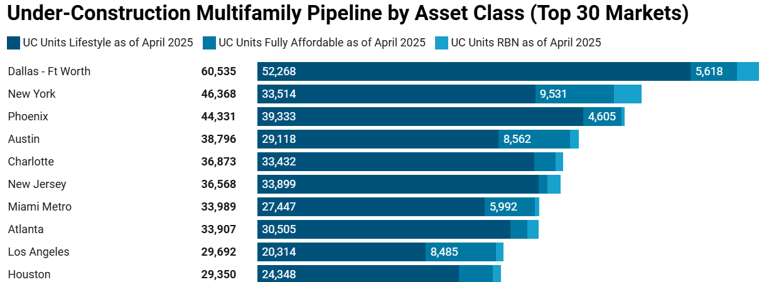
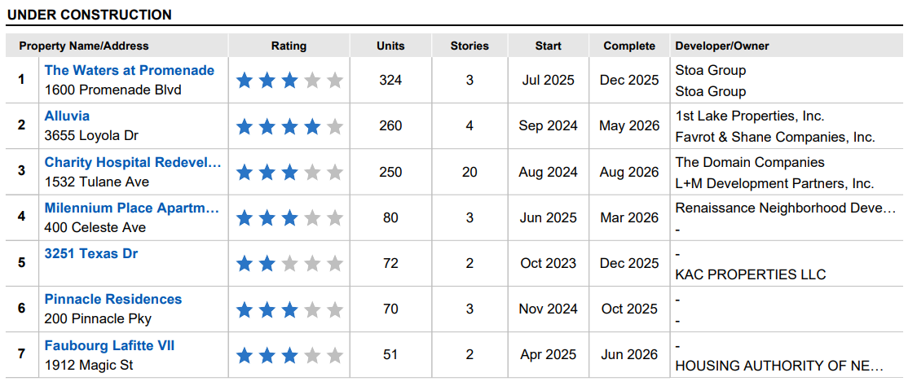
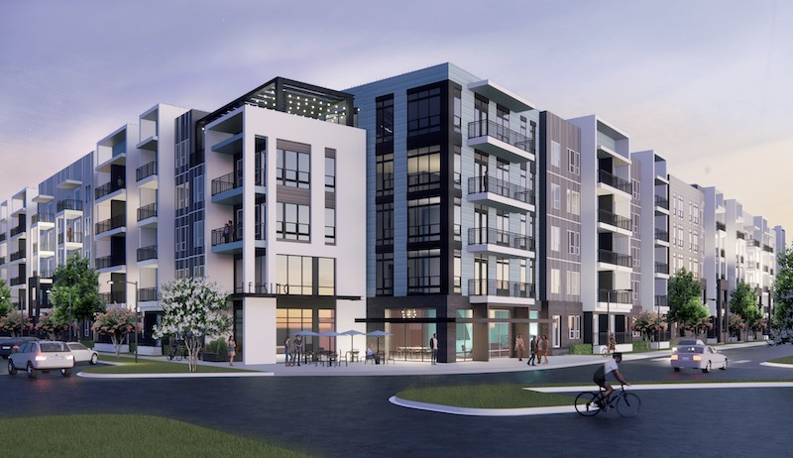
Market Fundamentals
BREAKING GROUND: THE EMERGENCE OF A NEW ECONOMY
At the national level, higher vacancies were also a primary culprit of slowing construction. From the trough in 2021 to the peak at the start of 2025, national vacancies had gone up by over 300 bps. In comparison, New Orleans' vacancies expanded by roughly half that rate over that timeframe, primarily driven by mixed tenant demand and a select new deliveries impacting the market.
THE 15TH ANNUAL
ECONOMIC & REAL ESTATE
SYMPOSIUM

Slide 9
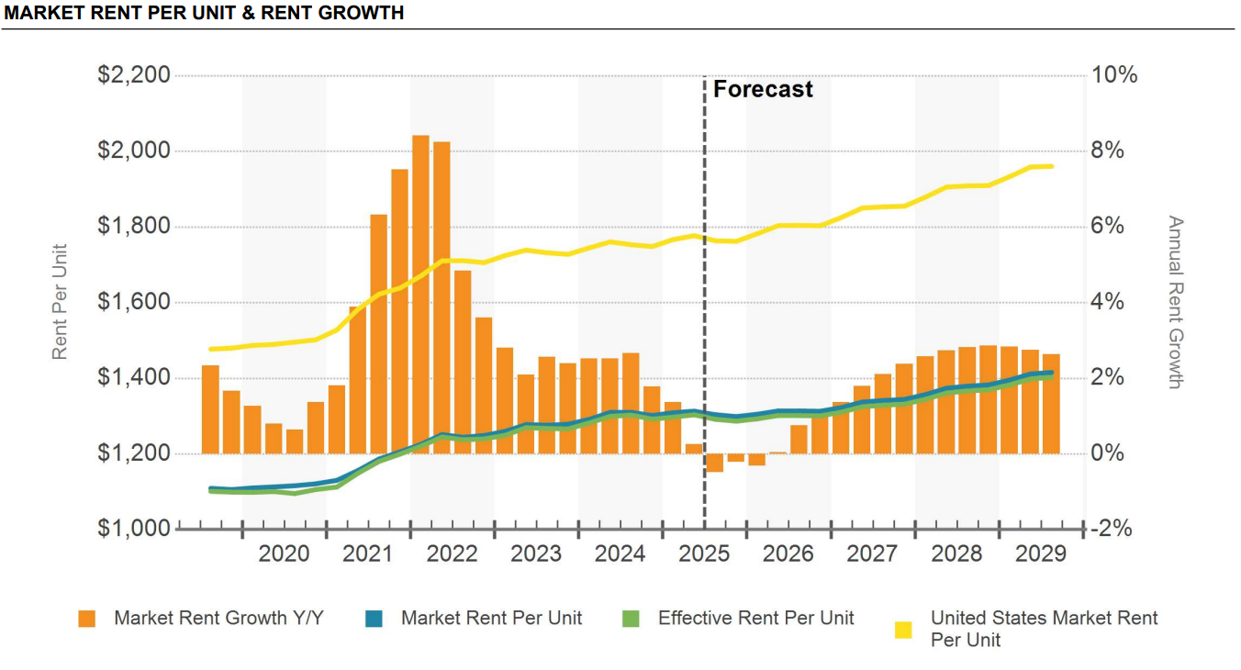
Market Fundamentals
Asking rents of $1,300 per month are approximately 26% below the national average. The median household income in New Orleans is $61,000, which compares to the national average of $77,700. At that income, tenants would spend about a quarter of their annual pre-tax income on rent in this market.
THE 15TH ANNUAL
ECONOMIC & REAL ESTATE
SYMPOSIUM

Slide 10
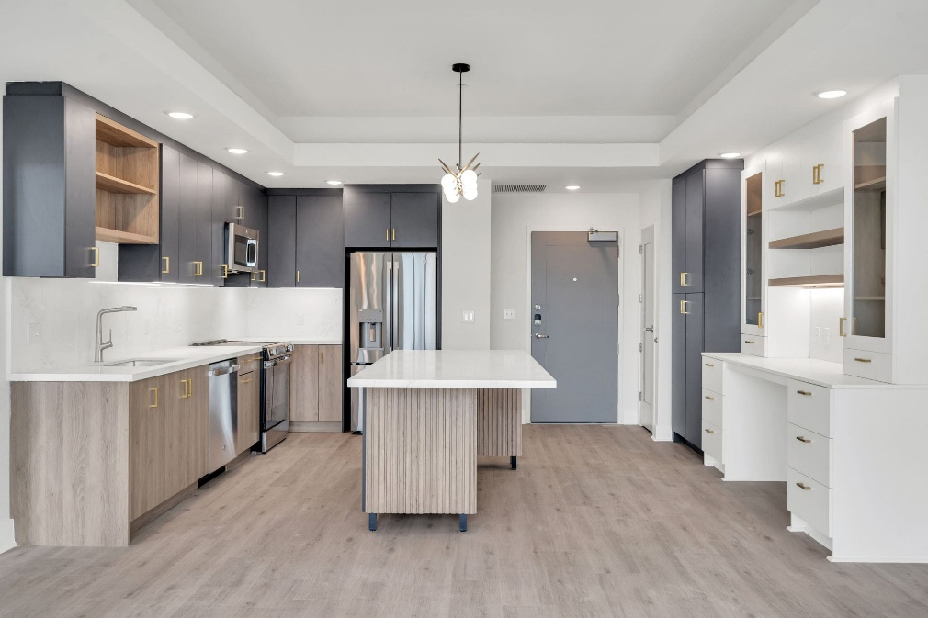
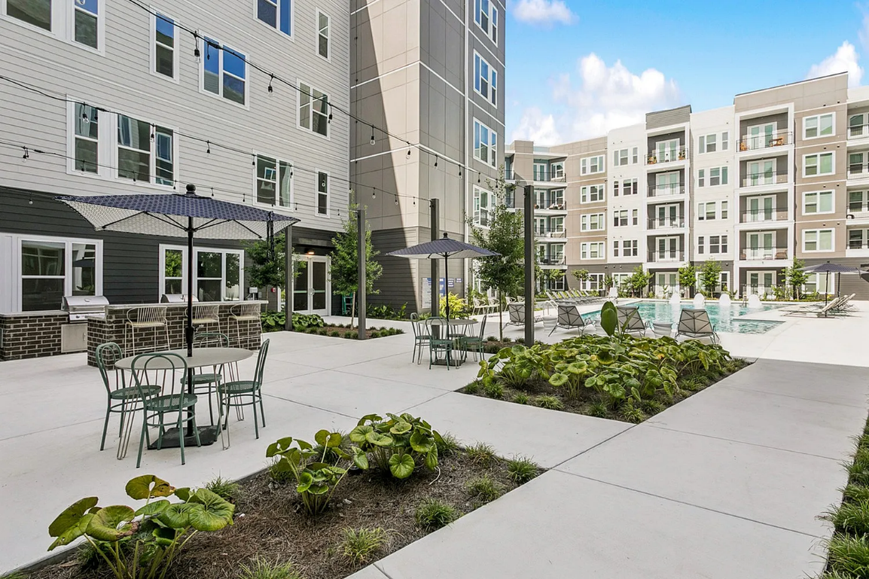
Market Fundamentals
BREAKING GROUND: THE EMERGENCE OF A NEW ECONOMY
New Construction achieving top rents
New construction multifamily has been achieving strong rents and lease up has been positive. The minimal new supply and lack of new inventory has let new construction projects benefit on achieving highest rents in the market.
Latitude Apartments
Metairie, LA
2025 YOC
Property Name | Year Built | Number Of Units | Avg Unit SF | Avg Asking/SF | Avg Asking Rent
The Jackson | 2025 | 205 | 830 | $2.39 | $1,984
Memoir Warehouse District | 2024 | 70 | 588 | $3.42 | $2,011
Latitude Apartments | 2025 | 170 | 1,166 | $2.27 | $2,647
The Metro at Clearview | 2024 | 270 | 918 | $2.23 | $2,047
The Metro at Clearview
Metairie, LA
2024 YOC
THE 15TH ANNUAL
ECONOMIC & REAL ESTATE
SYMPOSIUM
Notes:
but in the capital structure of the market itself. Parsons notes that many limited partners are currently tied up in existing commitments. With liquidity constrained, they’re reluctant to commit fresh capital until they see distributions or asset sales materialize.

Slide 11
BREAKING GROUND: THE EMERGENCE OF A NEW ECONOMY
Multifamily Challenges
Interest Rates
Insurance
Aging Inventory (New Orleans MSA specific)
Repairs & Maintenance / Capital Expense
Increased Construction Costs
Affordable housing (New Orleans MSA specific)
THE 15TH ANNUAL
ECONOMIC & REAL ESTATE
SYMPOSIUM

Slide 12
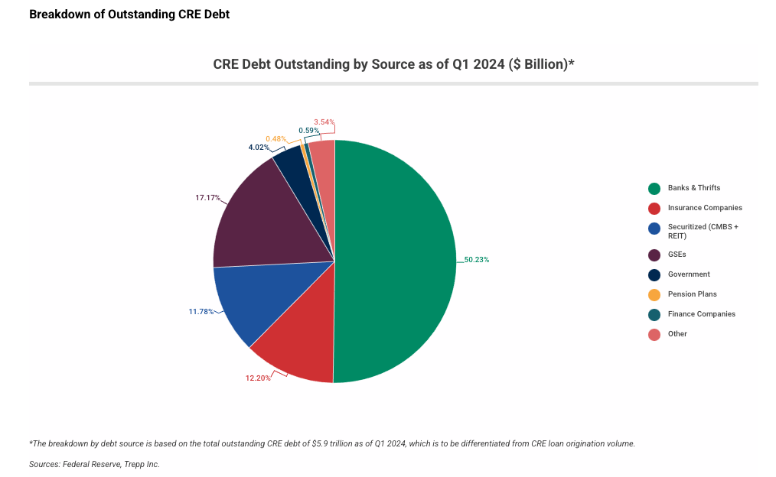
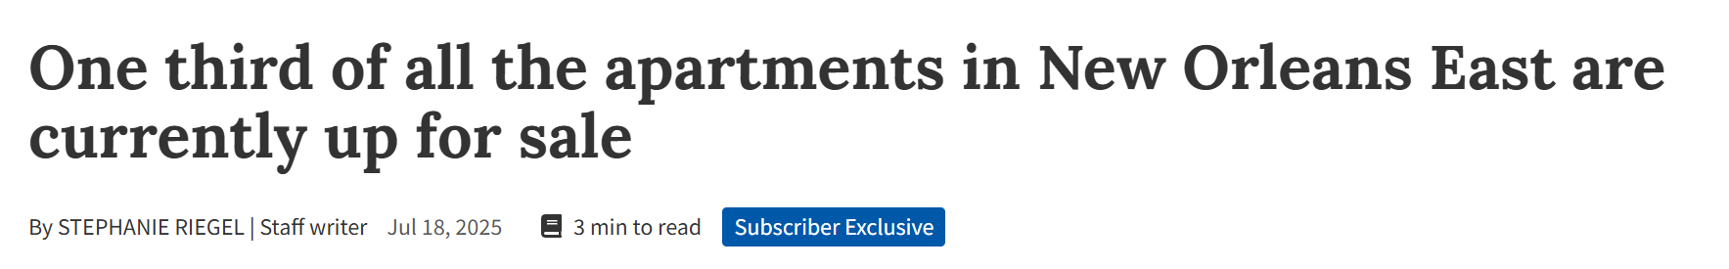
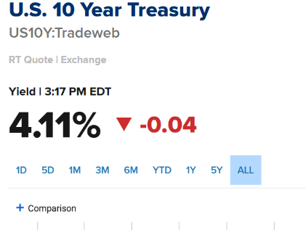
Multifamily Challenges
BREAKING GROUND: THE EMERGENCE OF A NEW ECONOMY
Interest Rates
Over $400 billion in multifamily debt is maturing by end of 2025
Bridge debt reliance is now causing a liquidity crisis in value-add projects
Loan-to-value (LTV) ratios are being restructured, often requiring 20-40% in new equity to refinance
Commercial real estate is standing at the edge of a massive debt cliff. Since the onset of rising interest rates in 2022, the industry has been propped up by lender modifications, extend-and-pretend strategies, and hope for rate cuts. But with nearly $2.8 trillion in commercial real estate debt set to mature by 2028
THE 15TH ANNUAL
ECONOMIC & REAL ESTATE
SYMPOSIUM

Slide 13
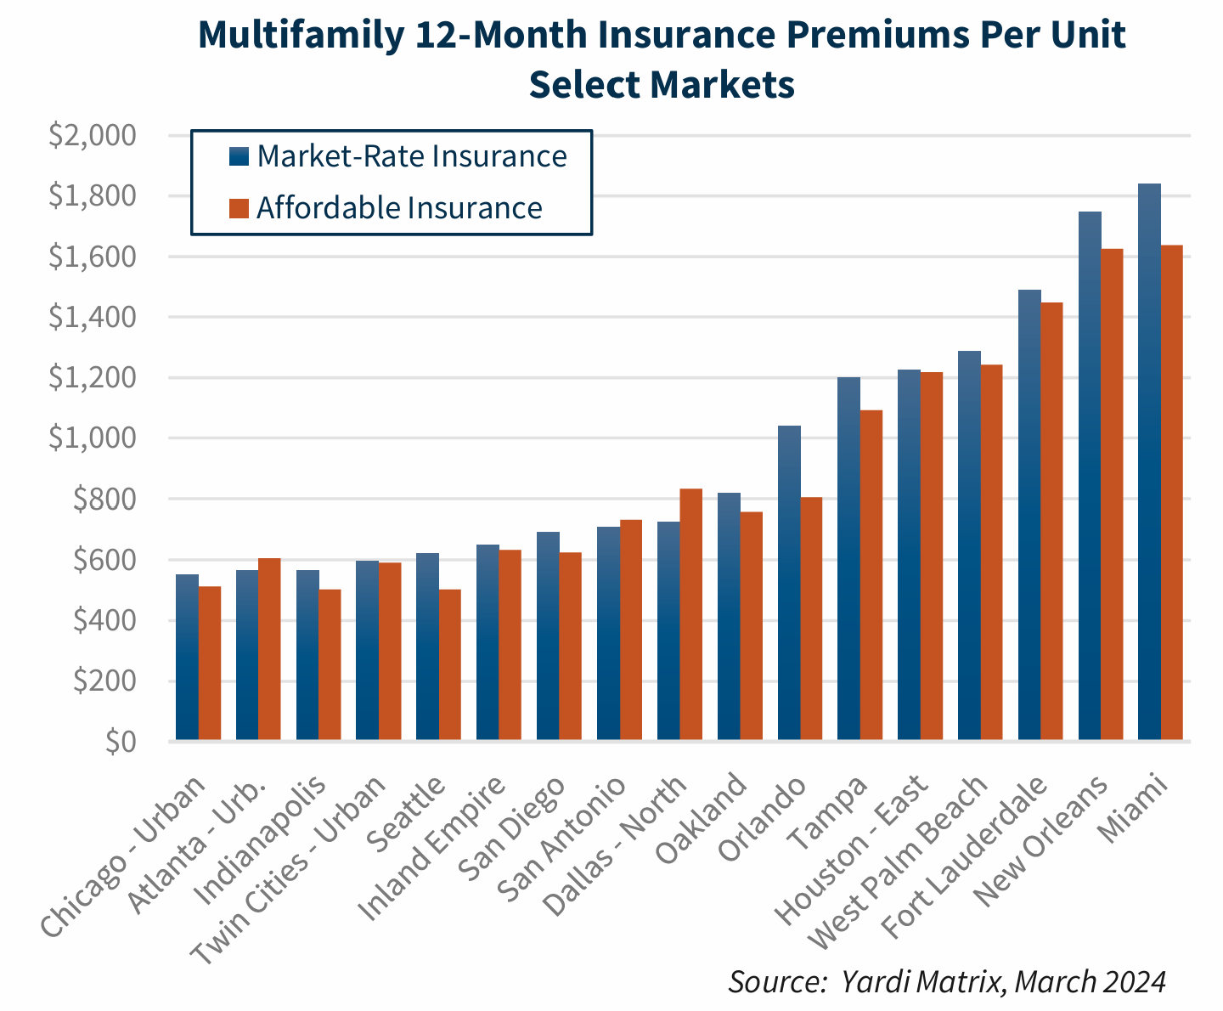
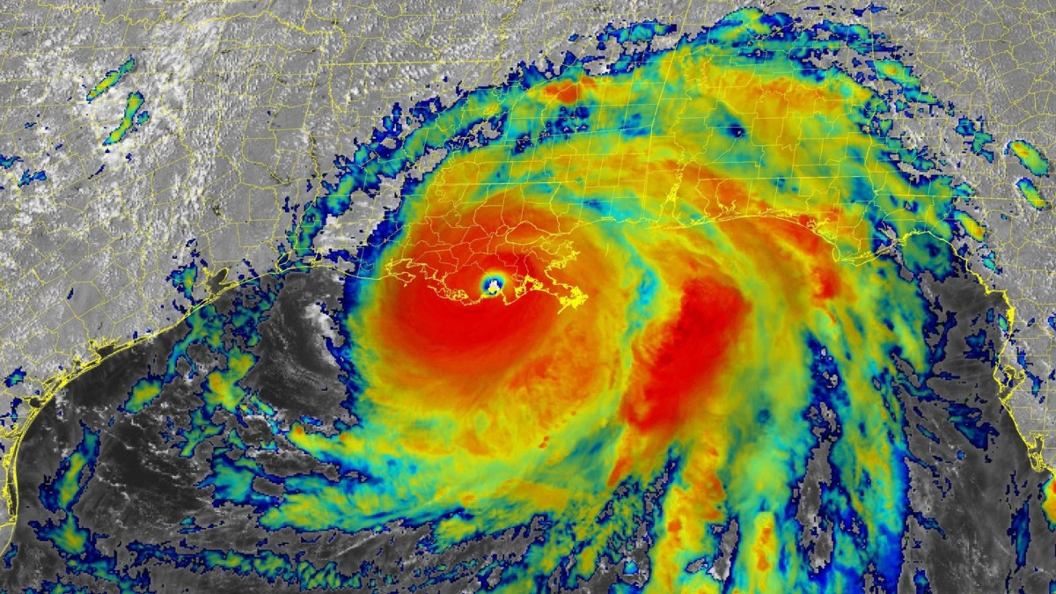
Multifamily Challenges
BREAKING GROUND: THE EMERGENCE OF A NEW ECONOMY
insurance
Owners have experienced significant increases over recent years. Survey respondents’ annual premiums increased by an average of 14 percent from 2021 to 2022, 22 percent from 2022 to 2023, and 45 percent from 2023 to 2024. On average, property insurance premiums in 2024 were double those of 2021, more than six times the increase in the Consumer Price Index over the same time period.
Hurricanes and flooding cost the insurance industry $120 billion in 2022, one of the costliest years on record.
Rising insurance costs have particularly dire implications for affordable housing providers as they have less flexibility to raise rents to cover increasing insurance costs and often face stricter limits on rent increases due to funding requirements.
As one affordable housing provider stated, “When insurance and other operating expenses are growing at a much faster rate, it doesn’t take long before properties cannot cover their operating expenses.” The financial strain poses a significant threat to the continued maintenance and development of affordable housing options.
THE 15TH ANNUAL
ECONOMIC & REAL ESTATE
SYMPOSIUM

Slide 14
Multifamily Challenges
BREAKING GROUND: THE EMERGENCE OF A NEW ECONOMY
Aging inventory | R&M & Capex
Orleans MSA Total Inventory (+25 units) | Inventory <1980 (+25 units)
67,460 | 32,786
% of Total Inventory | 49%
Aging inventory has seen an increase in repairs and maintenance costs across the country as well as an increase in the amount of capex and repairs needed for apartment complexes that are now reaching 40-50+ years old.
Inflation and tariffs are increasing costs of materials. Many of the materials relied on in property operations—from plumbing parts to flooring to light fixtures—aren’t made in the U.S. They’re imported from other countries.
City | Total Inventory (+25 units) | Inventory <1980 (+25 units) | % of Total Inventory
Lafayette | 25,109 | 6,814 | 27%
Baton Rouge | 51,871 | 16,380 | 31%
Shreveport | 34,216 | 12,379 | 36%
THE 15TH ANNUAL
ECONOMIC & REAL ESTATE
SYMPOSIUM
Notes:
The portfolio is located within a 3-mile radius along Interstate 10 in the East New Orleans Opportunity Zone. That area lost nearly 4,000 units after Hurricane Katrina, making these four properties one-third of the housing stock in the area,

Slide 15
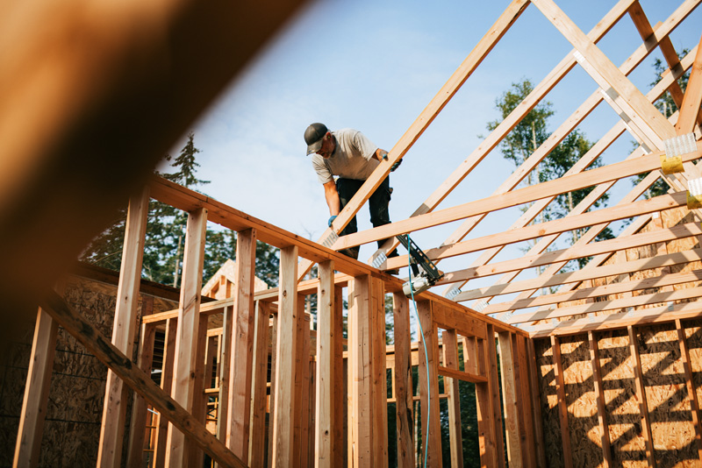
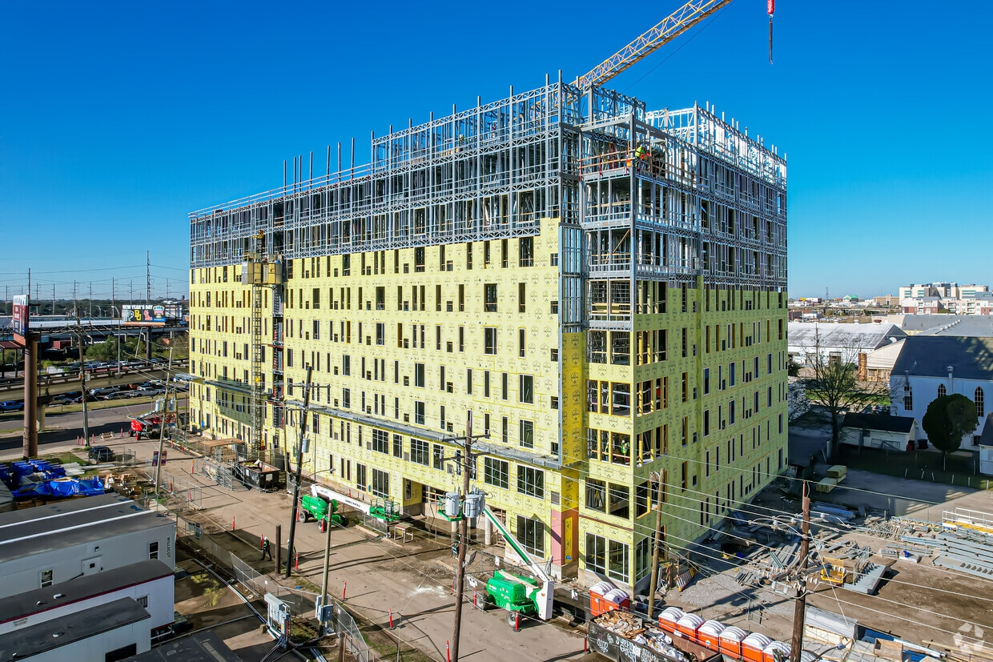
Multifamily Challenges
BREAKING GROUND: THE EMERGENCE OF A NEW ECONOMY
Increased construction costs
Broad global inflation
High interest rate construction loans
Skilled labor shortages
Insurance
HUD data shows that from March 2024 to March 2025, only 4% of Section 221(d)(4) and 223(f) loan closings were for market rate properties without green or affordable incentive qualification, suggesting severe underutilization due to high cost.
The Federal Housing Administration (FHA) has announced that effective October 1, it is reducing the FHA multifamily mortgage insurance premiums (MIP) for all multifamily programs to 25 basis points. Multifamily MIPs generally range from 25 basis points up to 95 basis points
The National Association of Home Builders (NAHB) reports that price growth for residential building materials rose for the fourth straight month in August 2025, reaching its highest level since January 2023
THE 15TH ANNUAL
ECONOMIC & REAL ESTATE
SYMPOSIUM

Slide 16
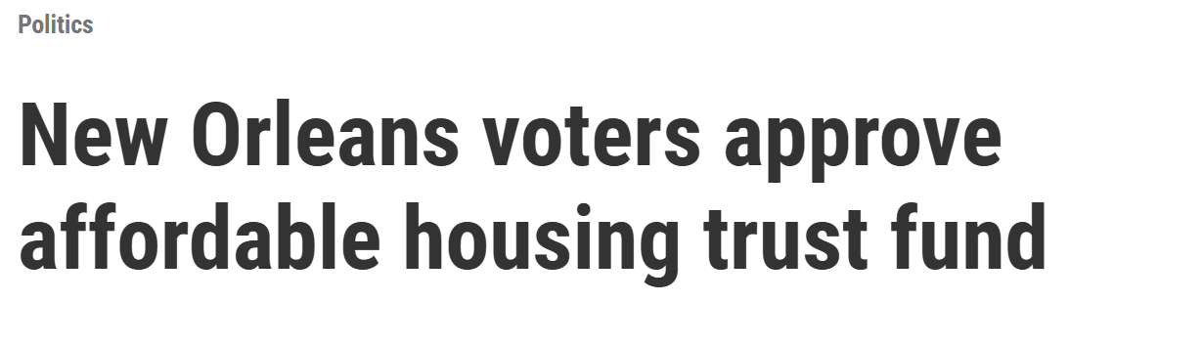
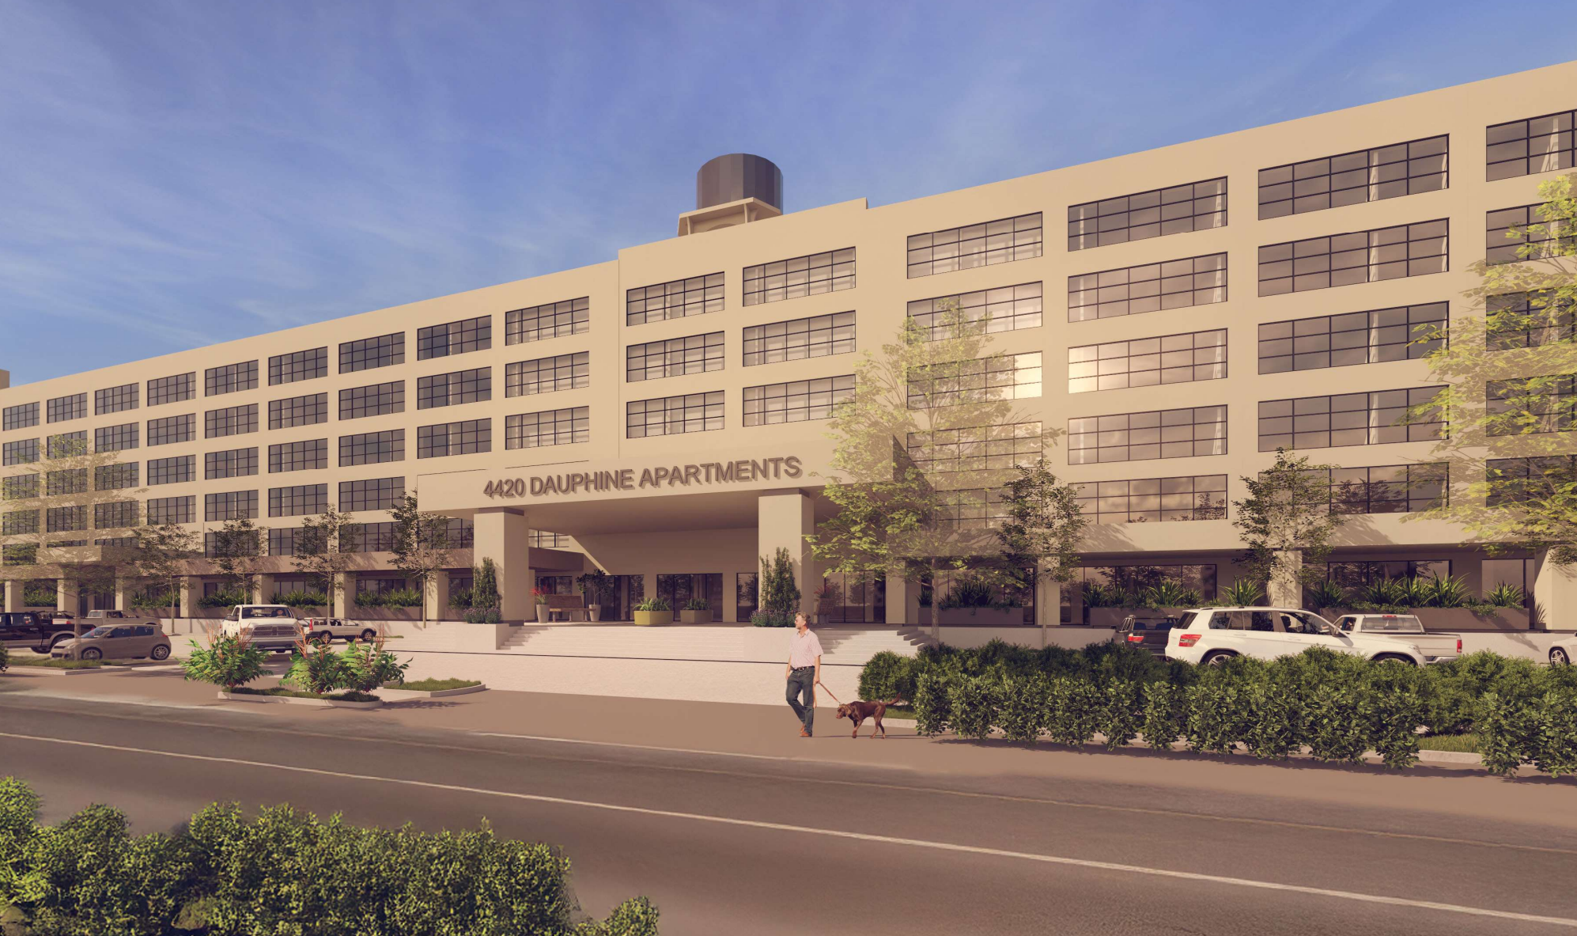
Multifamily Challenges
BREAKING GROUND: THE EMERGENCE OF A NEW ECONOMY
Affordable housing
“New Orleans currently needs approximately 44,000 additional affordable rental units, yet only 239 new units were added in the past year… More than 40% of households spend more than half their income on rent, and family homelessness has surged by 69% in the last two years.” – Brenda Breaux New Orleans Redevelopment Authority (NORA)
2% of the city’s annual budget
Roughly $17M annually
Starting 2026
$1B over next 20 years paired with private & federal funding sources
Louisiana Bond Commission approves $38M for two New Orleans housing projects
$22M allocated to Bywater development with 82 affordable units
$16M to redevelop historic Touro Shakespeare site into senior housing
NSA(Poland Naval Base)
redevelopment
294 unit workforce housing
Dedicated funding for affordable housing has shown to be successful in other cities, such as Washington, D.C. There, the program has produced over 9,000 new and rehabilitated units between its start in 2015 through 2022, according to the city's Housing and Community Development department.
THE 15TH ANNUAL
ECONOMIC & REAL ESTATE
SYMPOSIUM
Notes:
Make a note who made the quote.

Slide 17
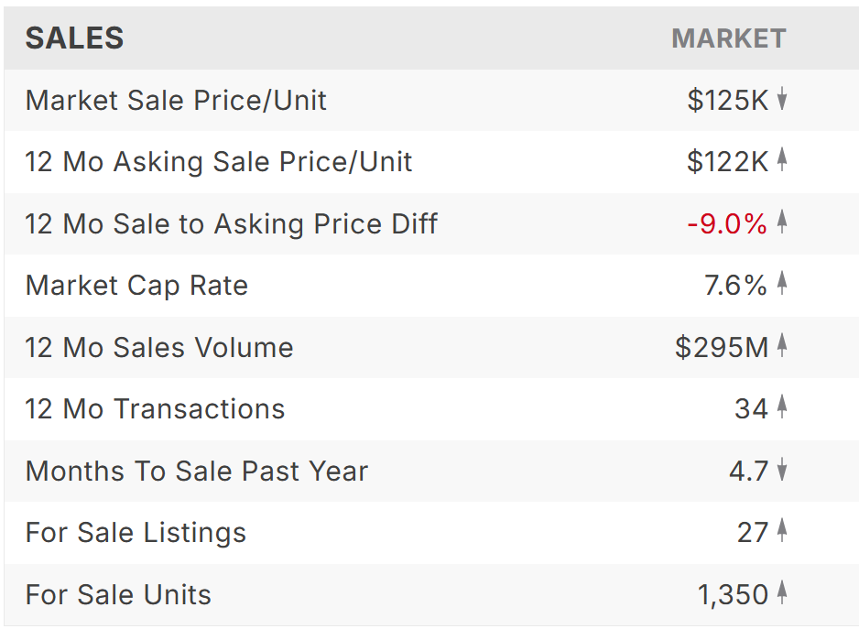
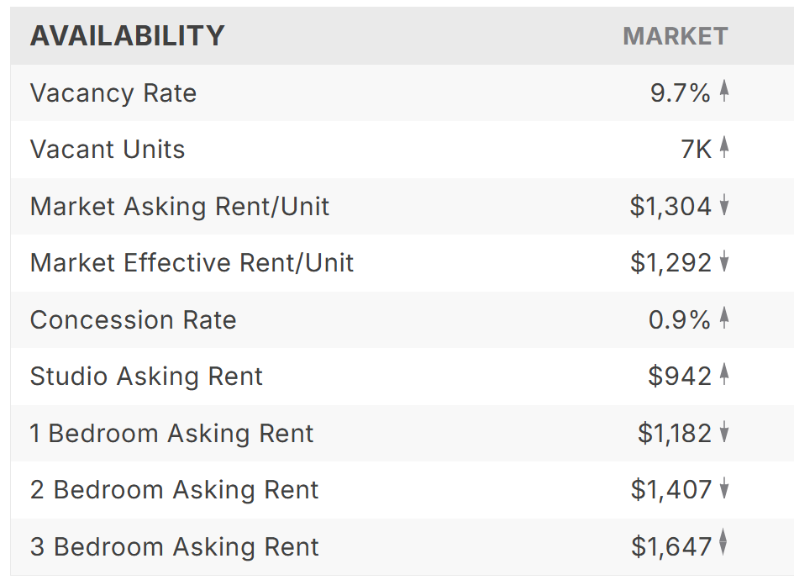
BREAKING GROUND: THE EMERGENCE OF A NEW ECONOMY
2025 Orleans Parish Multifamily
Investment sales
Many limited partners are currently tied up in existing commitments. With liquidity constrained, they’re reluctant to commit fresh capital until they see distributions or asset sales materialize.
Selling is difficult when valuations haven’t recovered and interest rates remain elevated. There’s a lot of capital waiting to be recycled, Investors want to see realized returns before they re-up, but that’s tough in a market where buyers are cautious and values are still depressed.
$112M - 2024
24 - 2024
8.4% - 2024
THE 15TH ANNUAL
ECONOMIC & REAL ESTATE
SYMPOSIUM
Notes:
but in the capital structure of the market itself. Parsons notes that many limited partners are currently tied up in existing commitments. With liquidity constrained, they’re reluctant to commit fresh capital until they see distributions or asset sales materialize.

Slide 18
BREAKING GROUND: THE EMERGENCE OF A NEW ECONOMY
Future Projections
More uncertainty
Timeline for interest rate reduction uncertain
Tons of equity sitting on the sideline/tied up in existing deals
Multifamily sales via loan maturities
Over $400 billion in multifamily debt is maturing by end of 2025
Forcing transactions and resetting basis
Opportunity for buyers to re-enter markets
Repositioning existing struggling assets
Opportunity for new ownership to stabilize struggling assets and bring units back online
THE 15TH ANNUAL
ECONOMIC & REAL ESTATE
SYMPOSIUM

